Slide 1



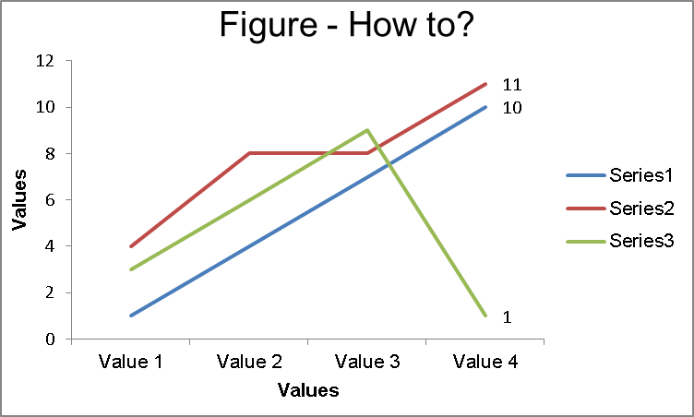
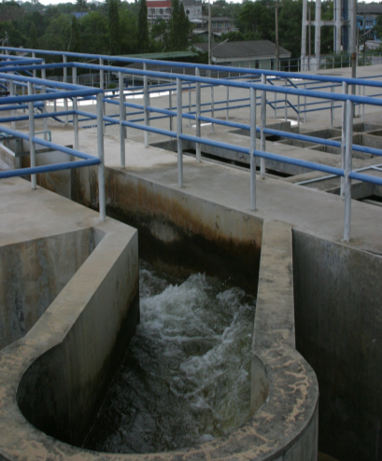
Title
Biofilms 2020
Your name, co-author 1 name, co-author 2 name
*Affiliation 1, contact details
**Affiliation 2, contact details
*** Affiliation 3, contact details
INTRODUCTION
Please keep the introduction simple, no more than 300 words in total. This example is to demonstrate the layout of an example poster for presentation at an IWA Conference. The purpose of a poster paper presentation is to promote informal discussion. It is a graphic display of a written manuscript. The poster presentation stands by itself as a summary of research and usually contains an overview of research objectives, experimental methods, materials, results and a discussion. Often, in poster presentations, a clear message in less words is more effective.
This example is to demonstrate the layout of an example poster for presentation at an IWA Conference. The purpose of a poster paper presentation is to promote informal discussion. It is a graphic display of a written manuscript. The poster presentation stands by itself as a summary of research and usually contains an overview of research objectives, experimental methods, materials, results and a discussion. Often, in poster presentations, a clear message in less words is more effective.
The colour palette should be as presented (IWA blue - RGB:0/174/239, IWA light blue – RGB: 0/174/239), font should all be ARIAL (Title = 80 points – white, Author names = 36 points – white, Affiliation = 28 points – white, Chapter title = 54 points – white, Text = 24 points- black aligned to the left, Captions and text remarks about figures = 20 points – black aligned to the left). Use graphs whenever its possible but do not overkill information per graph. Avoid very large tables, present them only with horizontal lines.
METHODS
DISCUSSION
The key message is: An interested individual who is not necessarily familiar with your field of expertise should be able to follow your poster. The purpose of poster paper presentations is to promote informal discussion. To achieve your goal you’ll need to two things:
A clear message (imagine a poster as an illustrated abstract);
An attractive and clear layout.
This template is a tool you should use to make the best out of your poster. We provide the attractive layout and the guidance; you provide the content and the best of your work.
Each paragraph should have more than 2 sentences and less than 5 sentences. Each sentence shouldn’t have more than 30 words. Use bullet points whenever it is possible, your audience will read them and discuss them with you. Use figures to structure your message and to show your key findings.
Focus on the key questions you want to answer. Begin by answering the “Why?” are you working on this followed by, “What am I adding?”, “How? Methods”, “What did I find?” and “What do I recommend?”
The clear areas between paragraphs and chapters are valuable. A direct message presented using a clear structure is easier to read and will attract your audience [1].
Table 1 – How to build a table for a poster
Title
Value 1 | 1 | 2 | 3
Value 2 | 4 | 5 | 6
Value 3 | 7 | 8 | 9
Value 4 | 10 | 11 | 12
This table only shows key figures, it is light and easily understandable and self explanatory. The side box only gives some hints on what is in the table
Fill with text. Fill with text. Fill with text. Fill with text. Fill with text. Fill with text. Fill with text. Fill with text. Fill with text. Fill with text. Fill with text. Fill with text. Fill with text.
Fill with text. Fill with text. Fill with text. Fill with text. Fill with text. Fill with text. Fill with text. Fill with text. Fill with text. Fill with text. Fill with text. Fill with text. Fill with text. Fill with text. Fill with text. Fill with text. Fill with text. Fill with text. Fill with text. Fill with text. Fill with text. Fill with text.
This figure shows trends, it is light and easily understandable and self explanatory. The side box only gives some hints on what is in the figure.
Use figures to support your text. The average visitor will pay more attention to figures than to text, keep it short and simple.
RESULTS
RESULTS
Fill with text. Fill with text. Fill with text. Fill with text. Fill with text. Fill with text. Fill with text. Fill with text. Fill with text. Fill with text. Fill with text. Fill with text. Fill with text.
Fill with text. Fill with text. Fill with text. Fill with text. Fill with text. Fill with text. Fill with text. Fill with text. Fill with text. Fill with text. Fill with text. Fill with text. Fill with text. Fill with text. Fill with text. Fill with text. Fill with text. Fill with text. Fill with text. Fill with text. Fill with text. Fill with text.
Figure 1 – How to build a graph for a poster
CONCLUSIONS
The pictures are used to show key points of the research. You should use them but avoid resolution overkill, more than 150 dpi but less than 300 dpi.
Save photos as .jpg or png (graphs as png) and take into account that web images are usually poor resolution.
If the picture is not yours, acknowledge the intellectual property of it.
Finish with a brief conclusion. Summarise your findings and list the key points of your research.
Be brief and direct
This shows the outcome of all of your efforts
Figure 1 – How to insert a figure (source: IWA)
References: List your references here. [1] Doe, J; Doe, J; Poster Template for Authors, IWA Headquarters, The Hague.
Acknowledgement: Use this box to acknowledge your partners and sponsors. The conference secretariat would like to thank you for your submissions and your willingness to apply our template and follow our advices.
inspiring change
www.iwahq.org

Slide 2
NOTE! In addition to the poster, we encourage, but do not require, that you prepare a 3-minute presentation of your work, similar to a short oral presentation. We suggest using up to three slides, but this is not a strict requirement.
Please focus on the “big picture” and key messages from your work. The presentation should be recorded and submitted to us beforehand, along with your poster. Please use the official PowerPoint template for oral and flash presentations, which will be available on the conference website.
Please record your presentation using free ZOOM software, which may be downloaded from https://zoom.us/download. The recordings will also be available for the access of conference audiences on the conference platform.
We kindly ask you to upload your poster and your video/voice recording prior to November 29 via a file sharing service that will be provided soon. The poster should be sent as a pdf, and your recording (if you prepared one) as an MP4 file.

